Slide 1
Neural Networks I
Srinivas Battula
VIT-AP University
WIN 2020-21

Slide 2
Neural Networks
Why neural networks?
Model representation
Examples and intuitions
Multi-class classification
Back propagation algorithm
Implementation & Applications
Deep Learning Architectures

Slide 3
Neural Networks
Why neural networks?

Slide 4
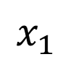
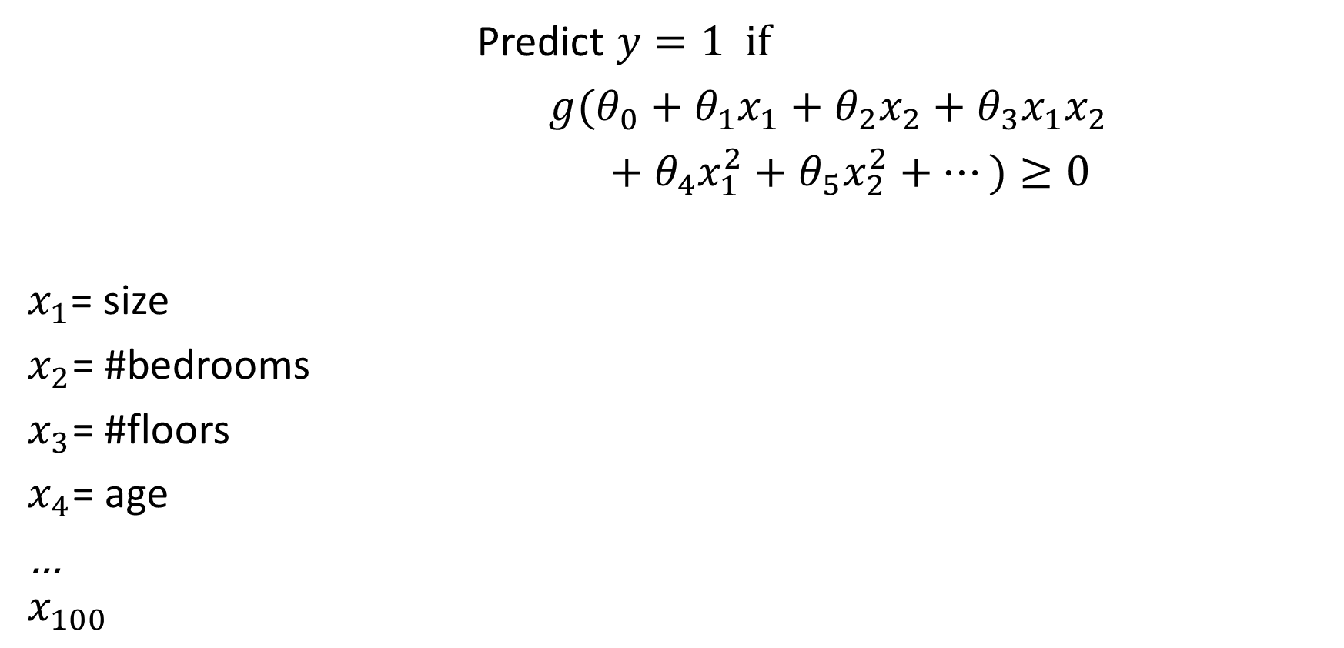
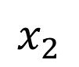
Non-linear classification
$$x_{2}$$
Predict $y=1 if$
$g(θ_{0}+θ_{1}x_{1}+θ_{2}x_{2}+θ_{3}x_{1}x_{2}$
$+ θ_{4}x_{1}^{2}+θ_{5}x_{2}^{2}+⋯)≥0$
$x_{1}$= size
$x_{2}$= #bedrooms
$x_{3}$= #floors
$x_{4}$= age
…
$$x_{100}$$
$$x_{1}$$
# Quadratic features?
# Cubic features?

Slide 5

What humans see

Slide 6
What computers see
243 | 239 | 240 | 225 | 206 | 185 | 188 | 218 | 211 | 206 | 216 | 225
242 | 239 | 218 | 110 | 67 | 31 | 34 | 152 | 213 | 206 | 208 | 221
243 | 242 | 123 | 58 | 94 | 82 | 132 | 77 | 108 | 208 | 208 | 215
235 | 217 | 115 | 212 | 243 | 236 | 247 | 139 | 91 | 209 | 208 | 211
233 | 208 | 131 | 222 | 219 | 226 | 196 | 114 | 74 | 208 | 213 | 214
232 | 217 | 131 | 116 | 77 | 150 | 69 | 56 | 52 | 201 | 228 | 223
232 | 232 | 182 | 186 | 184 | 179 | 159 | 123 | 93 | 232 | 235 | 235
232 | 236 | 201 | 154 | 216 | 133 | 129 | 81 | 175 | 252 | 241 | 240
235 | 238 | 230 | 128 | 172 | 138 | 65 | 63 | 234 | 249 | 241 | 245
237 | 236 | 247 | 143 | 59 | 78 | 10 | 94 | 255 | 248 | 247 | 251
234 | 237 | 245 | 193 | 55 | 33 | 115 | 144 | 213 | 255 | 253 | 251
248 | 245 | 161 | 128 | 149 | 109 | 138 | 65 | 47 | 156 | 239 | 255
190 | 107 | 39 | 102 | 94 | 73 | 114 | 58 | 17 | 7 | 51 | 137
23 | 32 | 33 | 148 | 168 | 203 | 179 | 43 | 27 | 17 | 12 | 8
17 | 26 | 12 | 160 | 255 | 255 | 109 | 22 | 26 | 19 | 35 | 24

Slide 7
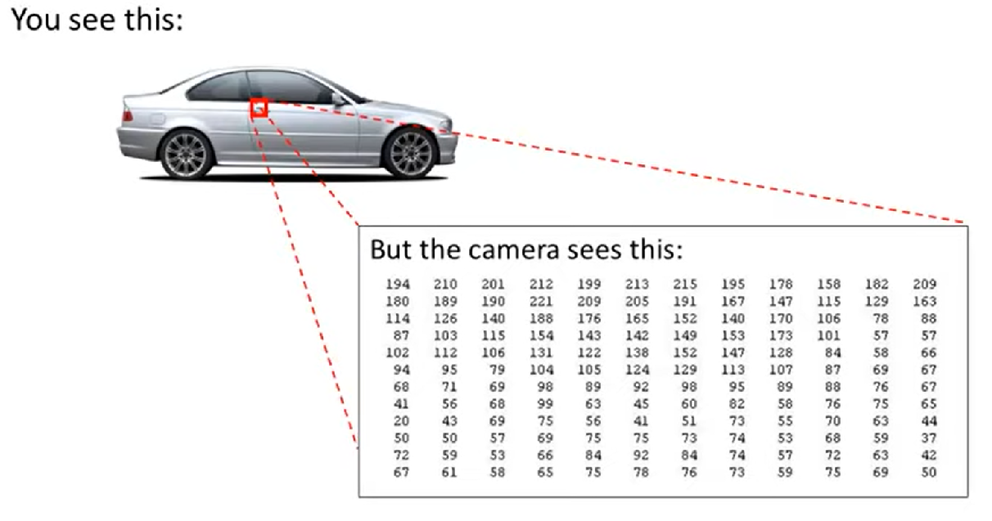

Slide 8
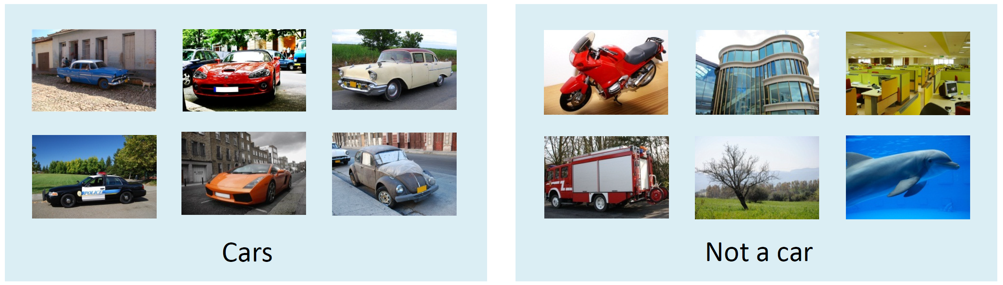
Computer Vision: Car detection
Testing:

Slide 9
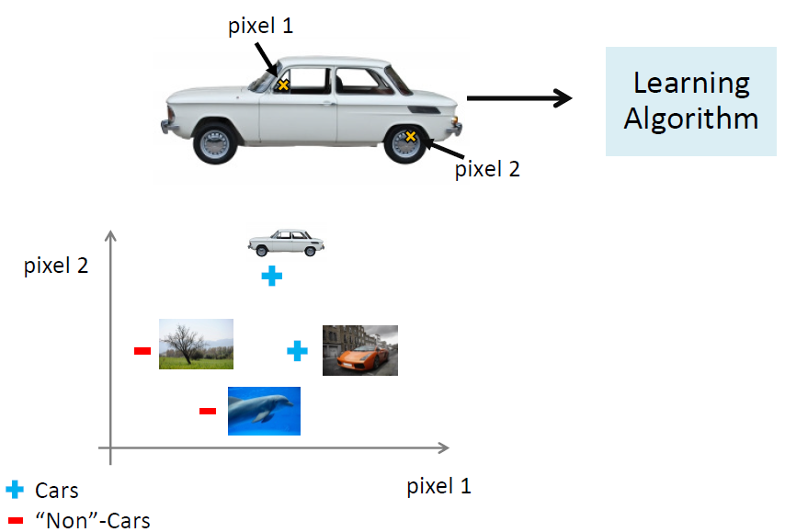
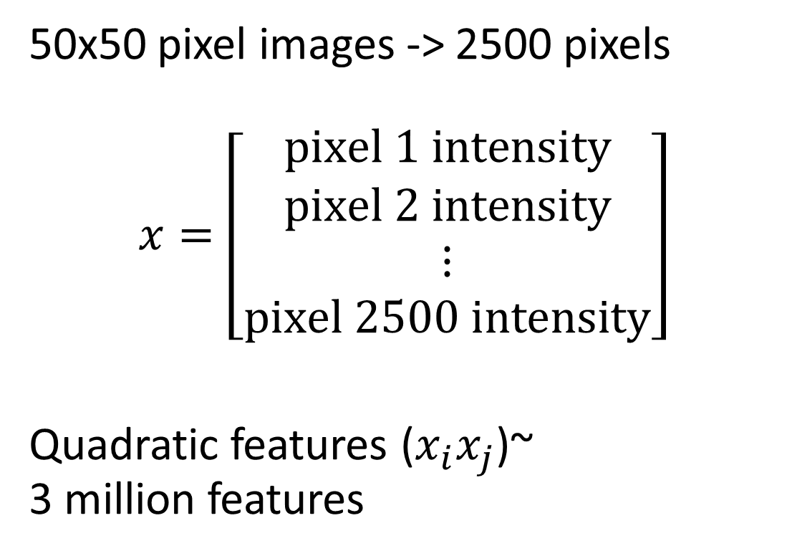
50x50 pixel images -> 2500 pixels
$$x=\left[\begin{aligned}pixel 1 intensity \\ pixel 2 intensity \\ ⋮ \\ pixel 2500 intensity\end{aligned}\right]$$
Quadratic features ($x_{i}x_{j}$)~ 3 million features

Slide 10
Neural Networks
Origins: Algorithms that try to mimic the brain.
Was very widely used in 80s and early 90s; popularity diminished in late 90s.
Recent resurgence: State-of-the-art technique for many applications

Slide 11
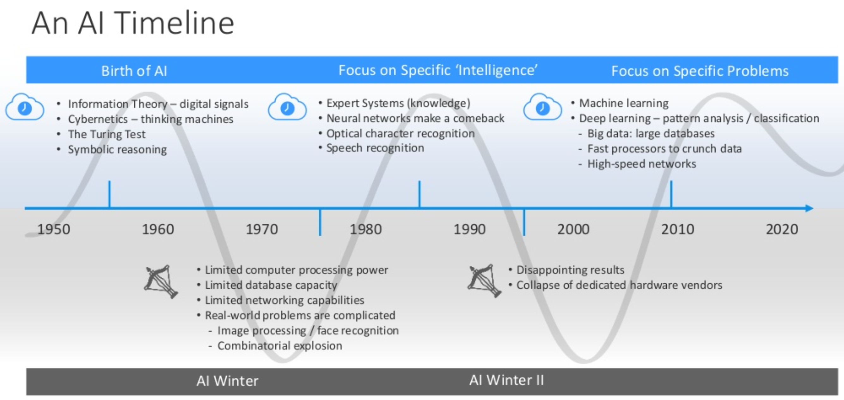
https://www.slideshare.net/dlavenda/ai-and-productivity

Slide 12
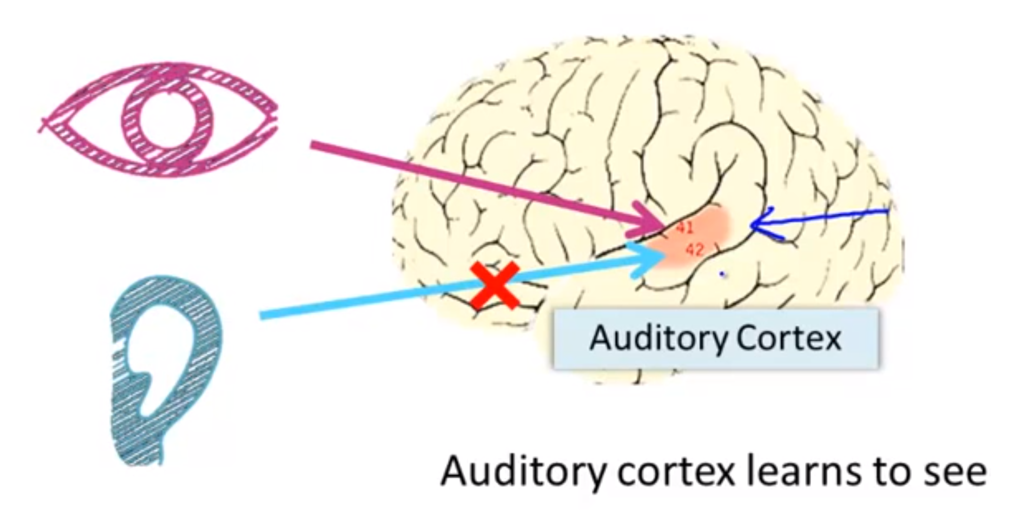
The “one learning algorithm” hypothesis
Auditory cortex --> takes sound signals If you cut the wiring from the ear to the auditory cortex
Re-route optic nerve to the auditory cortex
Auditory cortex learns to see
[Roe et al. 1992]

Slide 13
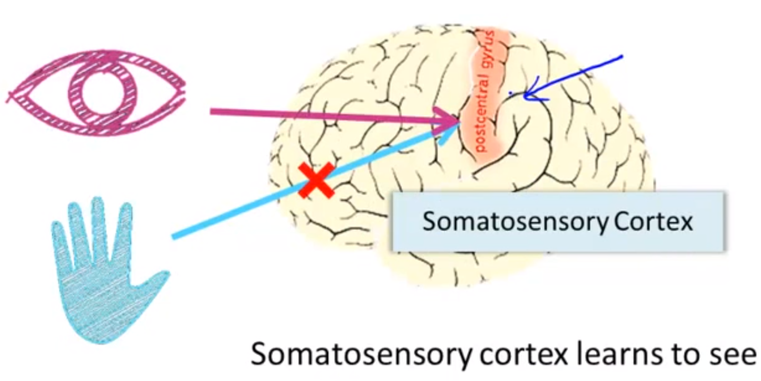
The “one learning algorithm” hypothesis
Somatosensory context (touch processing)
If you rewrite optic nerve to somatosensory cortex then it learns to see
[Metin and Frost 1989]

Slide 14
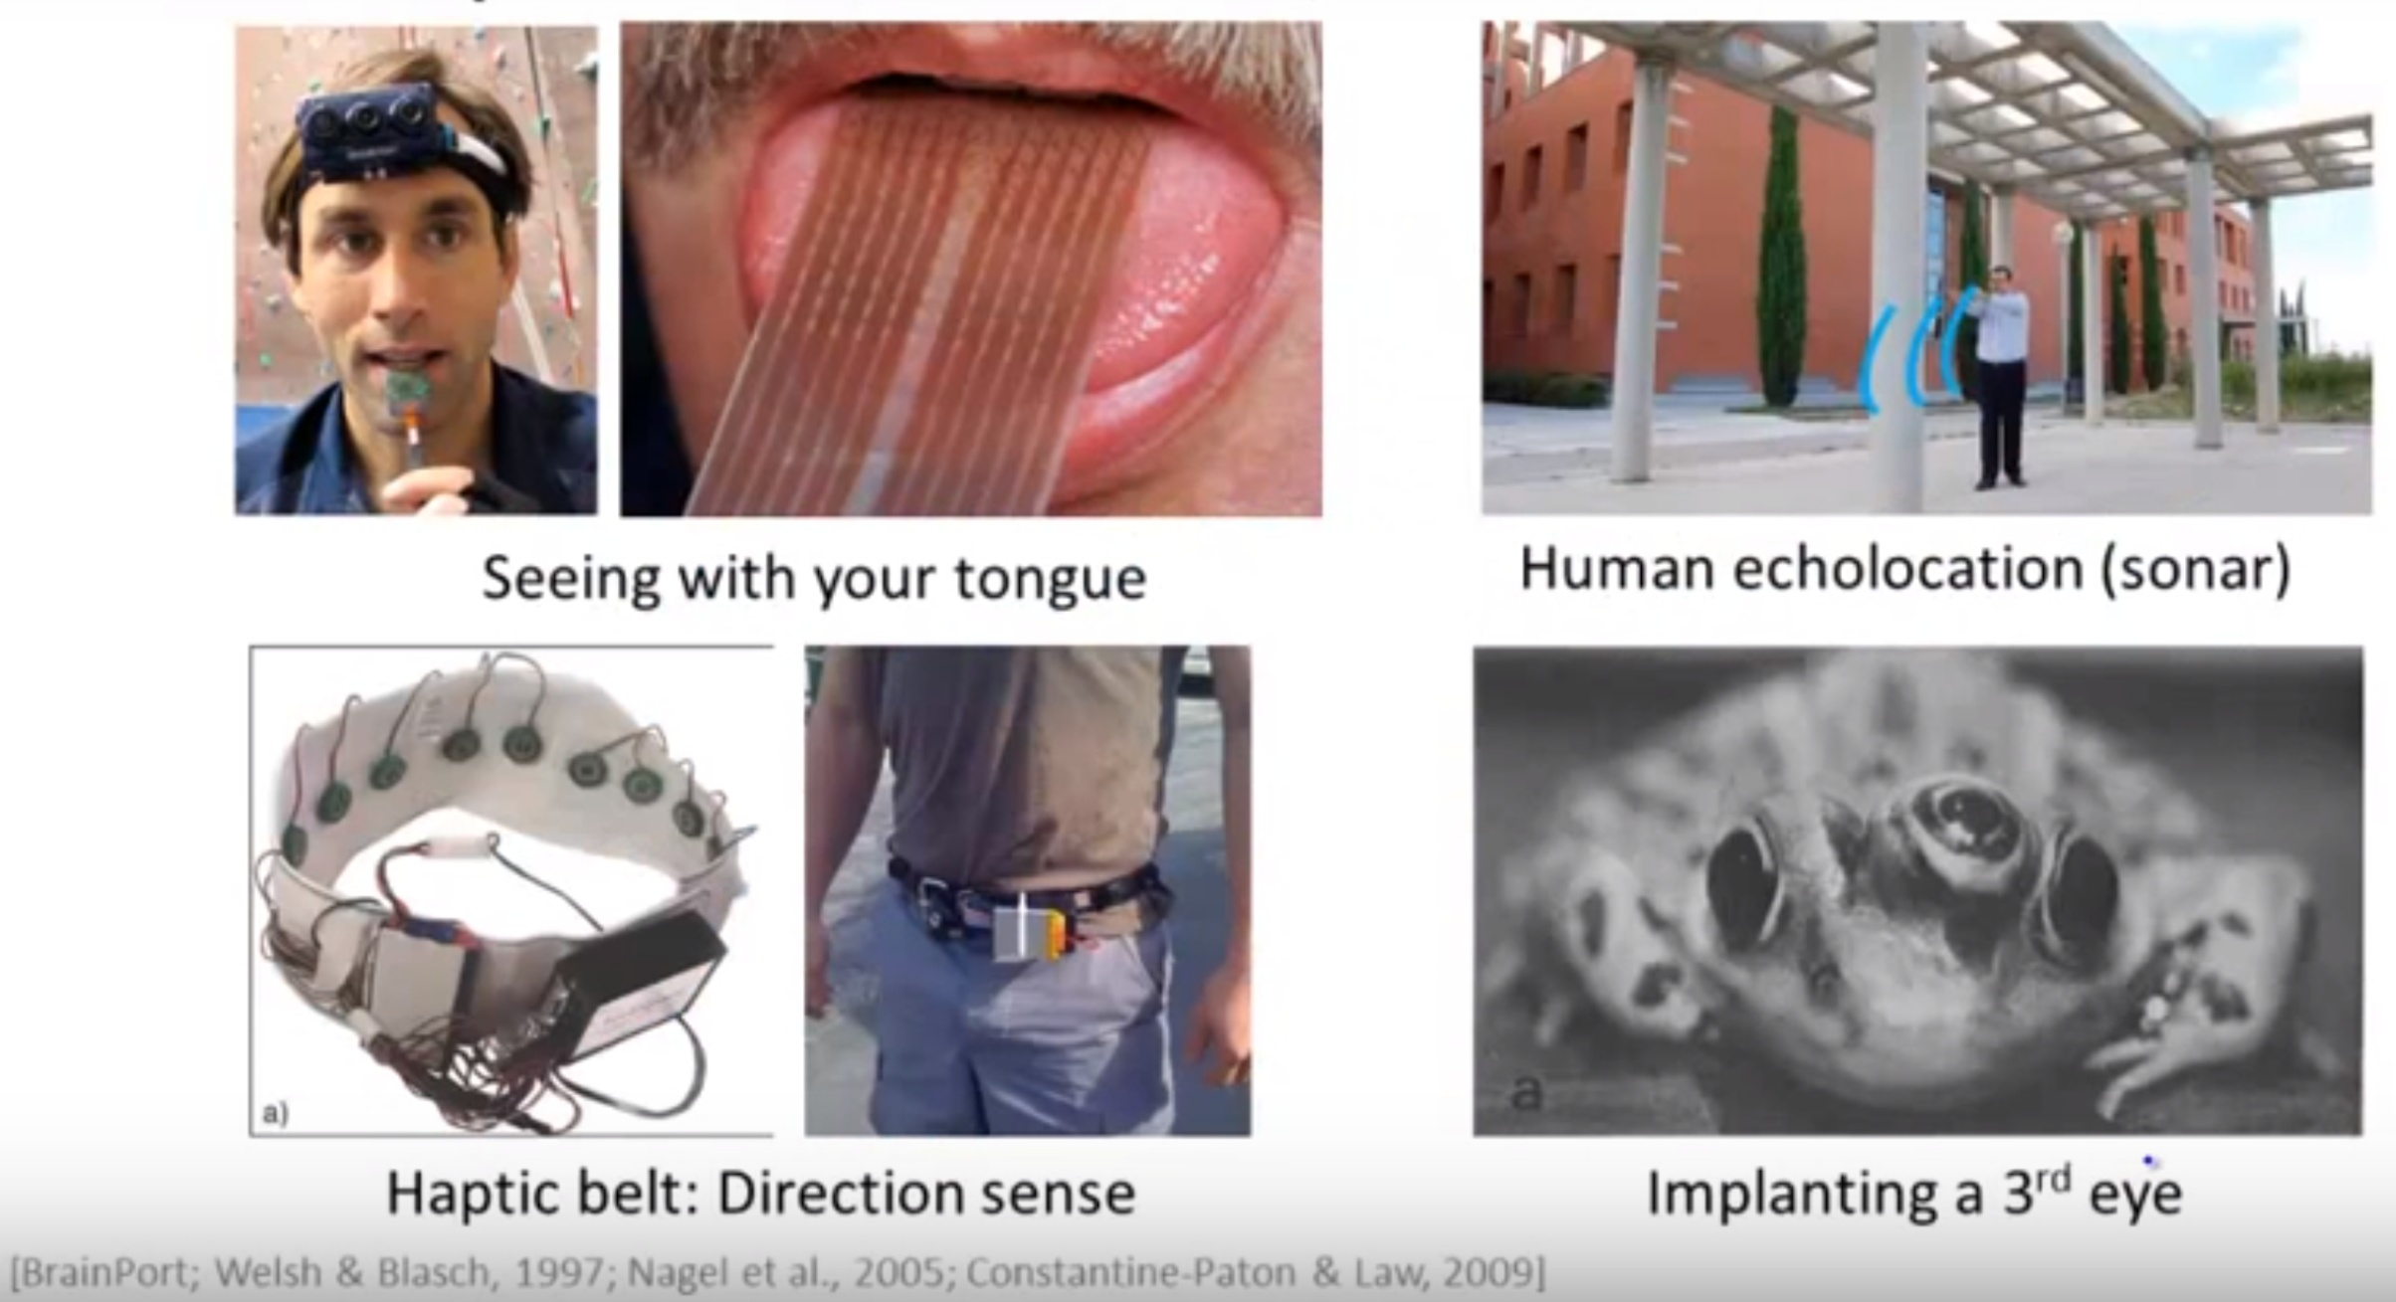
Sensor representations in the brain

Slide 15
Neural Networks
Why neural networks?
Model representation
Examples and intuitions
Multi-class classification

Slide 16

A single neuron in the brain
Input
Output

Slide 17
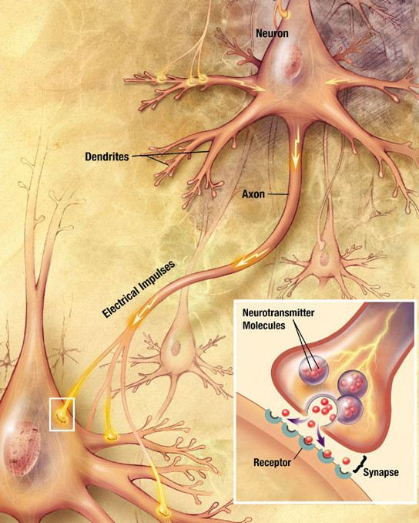
http://histoweb.co.za/082/082img002.html

Slide 18
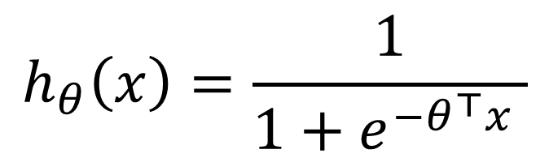
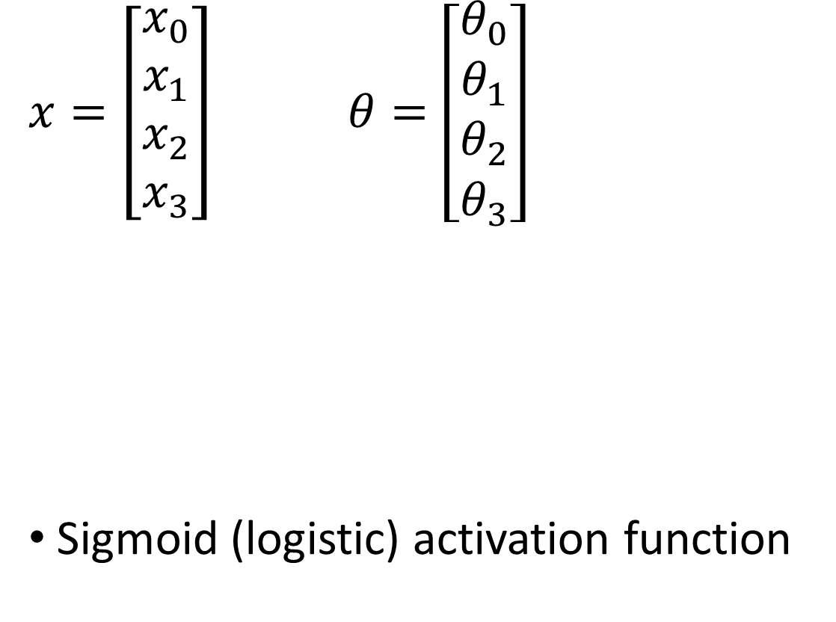
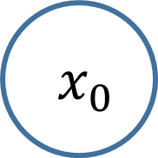
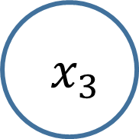


An artificial neuron: Logistic unit
$${ x}_{0}$$
“Bias unit”
$x=\left[\begin{aligned}x_{0} \\ x_{1} \\ x_{2} \\ x_{3}\end{aligned}\right]$$θ=\left[\begin{aligned}θ_{0} \\ θ_{1} \\ θ_{2} \\ θ_{3}\end{aligned}\right]$
Sigmoid (logistic) activation function
$${ x}_{1}$$
“Weights” “Parameters”
“Output”
$${ x}_{2}$$
$$h_{θ}\left(x\right)=\frac{1}{1+e^{−θ^{⊤}x} }$$
$${ x}_{3}$$
“Input”

Slide 19


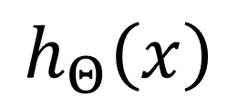
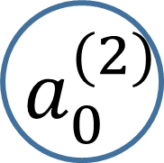

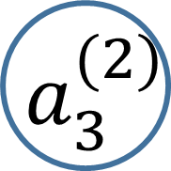

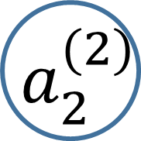

Neural network
$${ x}_{0}$$
$${ a}_{0}^{(2)}$$
$${ x}_{1}$$
$${ a}_{1}^{(2)}$$
“Output”
$${ x}_{2}$$
$${ a}_{2}^{(2)}$$
$$h_{Θ}\left(x\right)$$
$${ x}_{3}$$
$${ a}_{3}^{(2)}$$
Layer 1
Layer 2
Layer 3

Slide 20

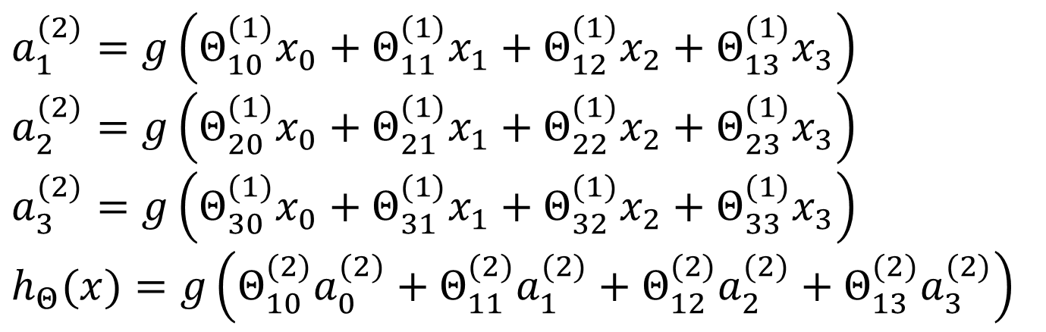

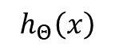
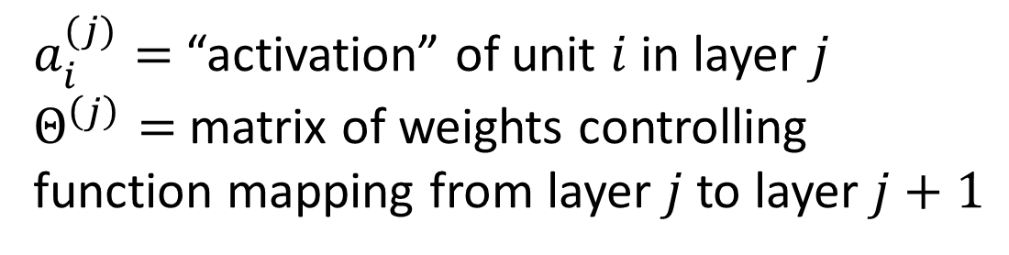
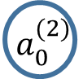


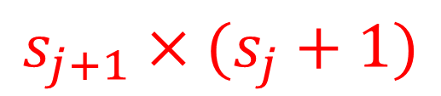



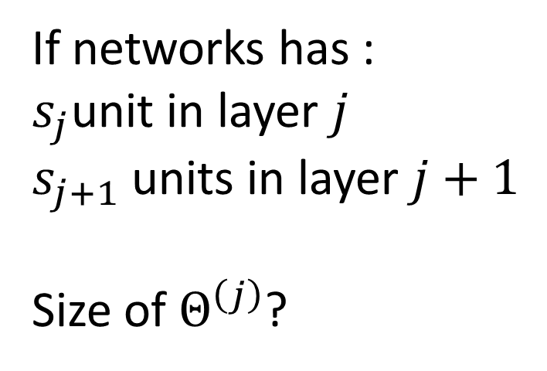
Neural network
$a_{i}^{(j)}=$ “activation” of unit $i$ in layer $j$
$Θ^{\left(j\right)}=$ matrix of weights controlling function mapping from layer $j$ to layer $j+1$
$${ x}_{0}$$
$${ a}_{0}^{(2)}$$
$${ x}_{1}$$
$${ a}_{1}^{(2)}$$
$${ x}_{2}$$
$${ a}_{2}^{(2)}$$
$$h_{Θ}\left(x\right)$$
If networks has :
$s_{j}$unit in layer $j$
$s_{j+1}$ units in layer $j+1$
Size of $Θ^{\left(j\right)}$?
$${ x}_{3}$$
$${ a}_{3}^{(2)}$$
$$a_{1}^{(2)}=g\left(Θ_{10}^{(1)}x_{0}+Θ_{11}^{(1)}x_{1}+Θ_{12}^{(1)}x_{2}+Θ_{13}^{(1)}x_{3}\right)$$
$$a_{2}^{(2)}=g\left(Θ_{20}^{(1)}x_{0}+Θ_{21}^{(1)}x_{1}+Θ_{22}^{(1)}x_{2}+Θ_{23}^{(1)}x_{3}\right)$$
$$a_{3}^{(2)}=g\left(Θ_{30}^{(1)}x_{0}+Θ_{31}^{(1)}x_{1}+Θ_{32}^{(1)}x_{2}+Θ_{33}^{(1)}x_{3}\right)$$
$$h_{Θ}(x)=g\left(Θ_{10}^{(2)}a_{0}^{(2)}+Θ_{11}^{(2)}a_{1}^{(2)}+Θ_{12}^{(2)}a_{2}^{(2)}+Θ_{13}^{(2)}a_{3}^{(2)}\right)$$
$$s_{j+1}×(s_{j}+1)$$

Slide 21
Neural network
Then Ɵ^{j} will be of dimensions [s_{j+1 X} s_{j} + 1]
Because
s_{j+1} is equal to the number of units in layer (j + 1)
s_{j} + 1 is equal to the number of units in layer j, plus an additional unit
Looking at the Ɵ matrix Column length is the number of units in the following layer
Row length is the number of units in the current layer + 1 (because we have to map the bias unit)
So, if we had two layers - 110 and 15 units in each
Then Ɵ^{j} would be = [15 x 111]
What are the computations ?
We have to calculate the activation for each node
That activation depends on
The input(s) to the node
The parameter associated with that node (from the Ɵ vector associated with that layer)

Slide 22
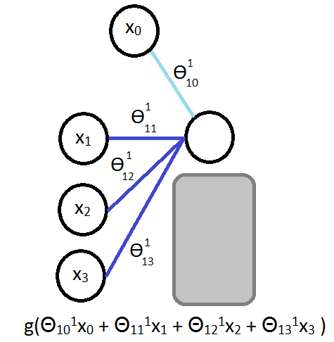
For example Ɵ₁₃¹ = means
1 - we're mapping to node 1 in layer l+1
3 - we're mapping from node 3 in layer l
1 - we're mapping from layer 1

Slide 23
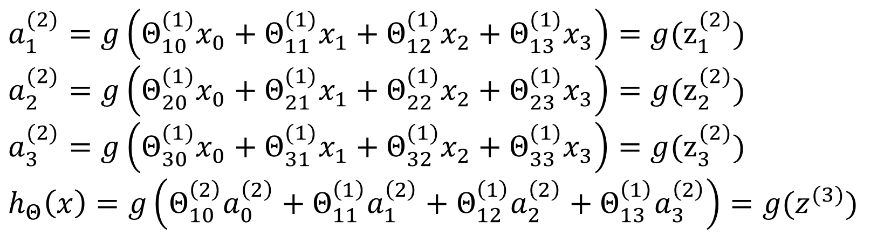
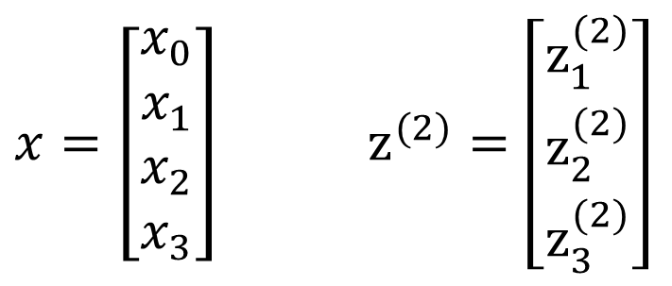
Neural network
“Pre-activation”
$x=\left[\begin{aligned}x_{0} \\ x_{1} \\ x_{2} \\ x_{3}\end{aligned}\right]$$z^{(2)}=\left[\begin{aligned}z_{1}^{(2)} \\ z_{2}^{(2)} \\ z_{3}^{(2)}\end{aligned}\right]$
$${ x}_{0}$$
$${ a}_{0}^{(2)}$$
$${ x}_{1}$$
$${ a}_{1}^{(2)}$$
$${ x}_{2}$$
$${ a}_{2}^{(2)}$$
$$h_{Θ}\left(x\right)$$
$${ x}_{3}$$
$${ a}_{3}^{(2)}$$
$$a_{1}^{(2)}=g\left(Θ_{10}^{(1)}x_{0}+Θ_{11}^{(1)}x_{1}+Θ_{12}^{(1)}x_{2}+Θ_{13}^{(1)}x_{3}\right)=g(z_{1}^{(2)})$$
$$a_{2}^{(2)}=g\left(Θ_{20}^{(1)}x_{0}+Θ_{21}^{(1)}x_{1}+Θ_{22}^{(1)}x_{2}+Θ_{23}^{(1)}x_{3}\right)=g(z_{2}^{(2)})$$
$$a_{3}^{(2)}=g\left(Θ_{30}^{(1)}x_{0}+Θ_{31}^{(1)}x_{1}+Θ_{32}^{(1)}x_{2}+Θ_{33}^{(1)}x_{3}\right)=g(z_{3}^{(2)})$$
$$h_{Θ}\left(x\right)=g\left(Θ_{10}^{\left(2\right)}a_{0}^{\left(2\right)}+Θ_{11}^{\left(1\right)}a_{1}^{\left(2\right)}+Θ_{12}^{\left(1\right)}a_{2}^{\left(2\right)}+Θ_{13}^{\left(1\right)}a_{3}^{\left(2\right)}\right)=g(z^{(3)})$$

Slide 24
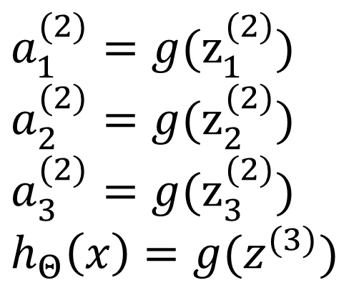
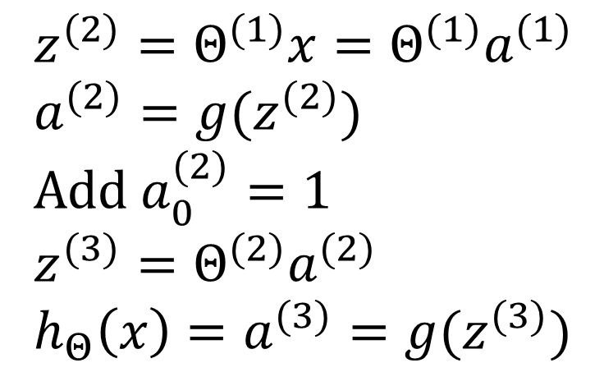
Neural network
“Pre-activation”
$x=\left[\begin{aligned}x_{0} \\ x_{1} \\ x_{2} \\ x_{3}\end{aligned}\right]$$z^{(2)}=\left[\begin{aligned}z_{1}^{(2)} \\ z_{2}^{(2)} \\ z_{3}^{(2)}\end{aligned}\right]$
$${ x}_{0}$$
$${ a}_{0}^{(2)}$$
$${ x}_{1}$$
$${ a}_{1}^{(2)}$$
$${ x}_{2}$$
$${ a}_{2}^{(2)}$$
$$h_{Θ}\left(x\right)$$
$${ x}_{3}$$
$${ a}_{3}^{(2)}$$
$$z^{(2)}=Θ^{(1)}x=Θ^{(1)}a^{(1)}$$
$$a^{(2)}=g(z^{(2)})$$
Add $a_{0}^{(2)}=1$
$$z^{(3)}=Θ^{(2)}a^{(2)}$$
$$h_{Θ}\left(x\right)=a^{(3)}=g(z^{(3)})$$
$$a_{1}^{(2)}=g(z_{1}^{(2)})$$
$$a_{2}^{(2)}=g(z_{2}^{(2)})$$
$$a_{3}^{(2)}=g(z_{3}^{(2)})$$
$$h_{Θ}\left(x\right)=g(z^{(3)})$$

Slide 25
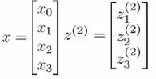
Forward Propagation
This process is also called forward propagation
Start off with activations of input unit
i.e. the x vector as input
Forward propagate and calculate the activation of each layer sequentially
This is a vectorised version of this implementation

Slide 26

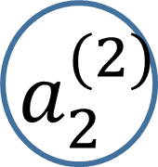


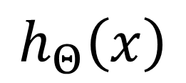
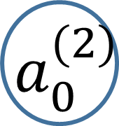

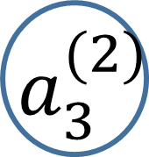
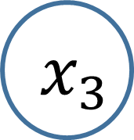
Neural network learning its own features
Diagram below looks a lot like logistic regression
$${ x}_{0}$$
$${ a}_{0}^{(2)}$$
$${ x}_{1}$$
$${ a}_{1}^{(2)}$$
$${ x}_{2}$$
$${ a}_{2}^{(2)}$$
$$h_{Θ}\left(x\right)$$
$${ x}_{3}$$
$${ a}_{3}^{(2)}$$

Slide 27
Neural network learning its own features
Layer 3 is a logistic regression node
The hypothesis output = g(Ɵ₁₀² a₀² + Ɵ₁₁² a₁² + Ɵ₁₂² a₂² + Ɵ₁₃² a₃²)
This is just logistic regression
The only difference is, instead of input a feature vector, the features are just values calculated by the hidden layer
The features a₁², a₂², and a₃² are calculated/learned - not original features
So the mapping from layer 1 to layer 2 (i.e. the calculations which generate the a² features) is determined by another set of parameters - Ɵ¹
So instead of being constrained by the original input features, a neural network can learn its own features to feed into logistic regression
Depending on the Ɵ¹ parameters you can learn some interesting things
Flexibility to learn whatever features it wants to feed into the final logistic regression calculation
So, if we compare this to previous logistic regression, you would have to calculate your own exciting features to define the best way to classify or describe something

Slide 28

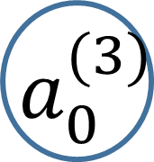
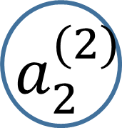



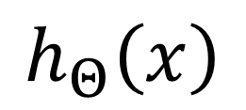
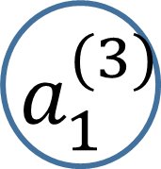



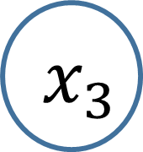
Other network architectures
$${ x}_{0}$$
$${ a}_{0}^{(2)}$$
$${ a}_{0}^{(3)}$$
$${ x}_{1}$$
$${ a}_{1}^{(2)}$$
$${ a}_{1}^{(3)}$$
$${ x}_{2}$$
$${ a}_{2}^{(2)}$$
$${ a}_{2}^{(3)}$$
$$h_{Θ}\left(x\right)$$
$${ x}_{3}$$
$${ a}_{3}^{(2)}$$

Slide 29

Architecture

Slide 31
Neural Networks
Why neural networks?
Model representation
Examples and intuitions
Multi-class classification

Slide 32
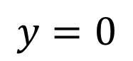
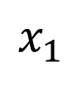
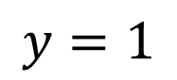
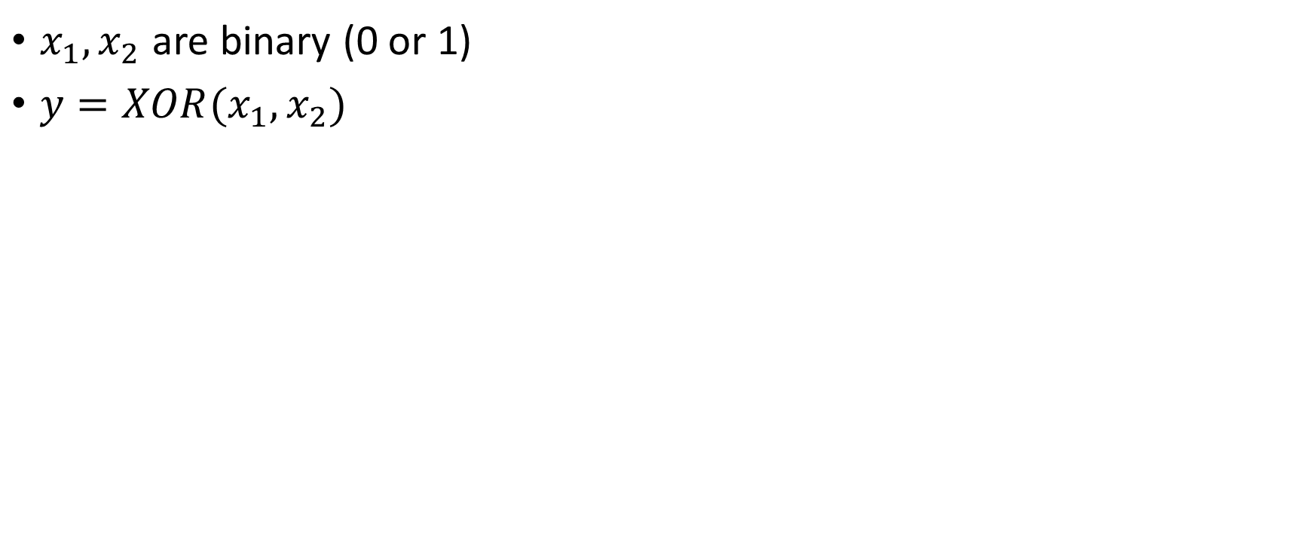
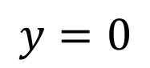
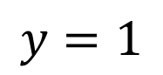
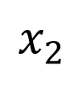
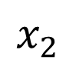

A complex Non-linear classification example using Neural Networks: XOR/XNOR
$x_{1}, x_{2}$ are binary (0 or 1)
$y=XOR(x_{1},x_{2})$
$$x_{2}$$
$$x_{2}$$
$$y=0$$
$$y=1$$
$$x_{1}$$
$$x_{1}$$
$$y=1$$
$$y=0$$

Slide 33










Simple example: AND
$x_{1}, x_{2}∈\left\{0, 1\right\}$
$y=x_{1} AND{ x}_{2}$
+1
$$−30$$
$$x_{1}$$ | $$x_{2}$$ | $$h_{Θ}\left(x\right)$$
0 | 0 | $$g\left(−30\right)≈0$$
0 | 1 | $$g(−10)≈0$$
1 | 0 | $$g(−10)≈0$$
1 | 1 | $$g(10)≈1$$
$$x_{1}$$
$$+20$$
$$h_{Θ}\left(x\right)$$
$$x_{2}$$
$$+20$$
$$h_{Θ}\left(x\right)=g(−30+20x_{1}+20x_{2})$$
$$h_{Θ}\left(x\right)≈x_{1} AND x_{2}$$

Slide 34



Simple example: OR
$x_{1}, x_{2}∈\left\{0, 1\right\}$
$y=x_{1} AND{ x}_{2}$
+1
$$−10$$
$$x_{1}$$ | $$x_{2}$$ | $$h_{Θ}\left(x\right)$$
0 | 0 | $$g\left(−10\right)≈0$$
0 | 1 | $$g(10)≈1$$
1 | 0 | $$g(10)≈1$$
1 | 1 | $$g(30)≈1$$
$$x_{1}$$
$$+20$$
$$h_{Θ}\left(x\right)$$
$$x_{2}$$
$$+20$$
$$h_{Θ}\left(x\right)=g(−10+20x_{1}+20x_{2})$$
$$h_{Θ}\left(x\right)≈x_{1} OR x_{2}$$

Slide 35





Simple example: NOT
$x_{1}, x_{2}∈\left\{0, 1\right\}$
$y=x_{1} AND{ x}_{2}$
+1
$$10$$
$$x_{1}$$ | $$h_{Θ}\left(x\right)$$
0 | $$g\left(10\right)≈1$$
1 | $$g(−10)≈0$$
$$x_{1}$$
$$−20$$
$$h_{Θ}\left(x\right)$$
$$h_{Θ}\left(x\right)=g(10−20x_{1})$$
$$h_{Θ}\left(x\right)≈NOT x_{1}$$

Slide 36




































Putting it together: $x_{1} XNOR$$x_{2}$
+1
+1
+1
$$−30$$
$$10$$
$$−10$$
$$x_{1}$$
$$+20$$
$$h_{Θ}\left(x\right)$$
$$x_{1}$$
$$−20$$
$$h_{Θ}\left(x\right)$$
$$x_{1}$$
$$+20$$
$$h_{Θ}\left(x\right)$$
$$x_{2}$$
$$+20$$
$$x_{2}$$
$$−20$$
$$x_{2}$$
$$+20$$
$$x_{1} AND{ x}_{2}$$
+1
$$(NOT x_{1}) AND{ (NOT x}_{2})$$
$$x_{1} OR x_{2}$$
$$x_{1}$$ | $$x_{2}$$ | $$a_{1}^{(2)}$$ | $$a_{2}^{(2)}$$ | $$h_{Θ}\left(x\right)$$
0 | 0 | 0 | 1 | $$1$$
0 | 1 | 0 | 0 | $$0$$
1 | 0 | 0 | 0 | $$0$$
1 | 1 | 1 | 0 | $$1$$
+1
$$−30$$
$$a_{1}^{(2)}$$
$$−10$$
$$+20$$
$$+20$$
$$x_{1}$$
$$+20$$
$$10$$
$$−20$$
$$a_{2}^{(2)}$$
$$+20$$
$$x_{2}$$
$$−20$$

Slide 37

Layer 1
Visualizing and Understanding Convolutional Networks [Zeiler and Fergus, ECCV 2014]

Slide 38

Layer 2
Visualizing and Understanding Convolutional Networks [Zeiler and Fergus, ECCV 2014]

Slide 39

Layer 3
Visualizing and Understanding Convolutional Networks [Zeiler and Fergus, ECCV 2014]

Slide 40

Layer 4 and 5
Visualizing and Understanding Convolutional Networks [Zeiler and Fergus, ECCV 2014]

Slide 41
Neural Networks
Why neural networks?
Model representation
Examples and intuitions
Multi-class classification

Slide 42








Multiple output units: One-vs-all
$${ x}_{1}$$
$${ a}_{1}^{(2)}$$
$${ a}_{1}^{(3)}$$
Pedestrian?
$${ x}_{2}$$
$${ a}_{2}^{(2)}$$
$${ a}_{2}^{(3)}$$
Car?
$${ a}_{3}^{(2)}$$
Motocycle?
Truck?

Slide 43









Multiple output units: One-vs-all
$${ x}_{1}$$
$${ a}_{1}^{(2)}$$
$${ a}_{1}^{(3)}$$
$${ x}_{2}$$
$${ a}_{2}^{(2)}$$
$${ a}_{2}^{(3)}$$
$$h_{Θ}\left(x\right)∈R^{4}$$
$${ a}_{3}^{(2)}$$
Training set : $\left(x^{\left(1\right)},y^{(1)}\right),\left(x^{\left(2\right)},y^{(2)}\right), ⋯\left(x^{(m)},y^{(m)}\right),$
$y^{(i)}$ one of $\left[\begin{aligned}1 \\ 0 \\ 0 \\ 0\end{aligned}\right], \left[\begin{aligned}0 \\ 1 \\ 0 \\ 0\end{aligned}\right],\left[\begin{aligned}0 \\ 0 \\ 1 \\ 0\end{aligned}\right],\left[\begin{aligned}0 \\ 0 \\ 0 \\ 1\end{aligned}\right]$

Slide 44




















Things to remember
$${ x}_{0}$$
$${ a}_{0}^{(2)}$$
Why neural networks?
Model representation
Examples and intuitions
Multi-class classification
$${ x}_{1}$$
$${ a}_{1}^{(2)}$$
“Output”
$${ x}_{2}$$
$${ a}_{2}^{(2)}$$
$$h_{Θ}\left(x\right)$$
$${ x}_{3}$$
$${ a}_{3}^{(2)}$$
Layer 1
Layer 2
Layer 3
+1
+1
$$−30$$
$$a_{1}^{(2)}$$
$$+20$$
$$−10$$
$$+20$$
$$+20$$
$$x_{1}$$
$$−20$$
$$10$$
$$x_{2}$$
$$a_{2}^{(2)}$$
$$+20$$
$$−20$$

